Slide 1

RUNGTA COLLEGE OF DENTAL SCIENCES & RESEARCH
TITLE OF THE TOPIC-
MANAGEMENT OF CLAS II MALOCLUSSION
DEPARTMENT OF ORTHODONTICS AND DENTOFACIAL ORTHOPAEDICS

Slide 2
Specific learning Objectives
CORE AREAS | DOMAIN | CATEGORY
Introduction | AFFECTIVE | NICE TO KNOW
Classification of CIass II malocclusion | AFFECTIVE | NICE TO KNOW
Clinical features of Class II malocclusion Div. 1 and Div. 2 | COGNITIVE | MUST KNOW
Etiologic considerations of Class II malocclusion | COGNITIVE | MUST KNOW
Management of Class II malocclusion | PSYCHOMOTOR | MUST KNOW

Slide 3
CONTENTS
Introduction
Classification of CIass II malocclusion
Clinical features of Class II malocclusion Div. 1 and Div. 2
Etiologic considerations of Class II malocclusion
Management of Class II malocclusion
  Management of functional disturbances
  Management of Class II malocclusion during mixed dentition period
  Management of Class II malocclusion with maxillary prognathism with normal mandible
  Management of mandibular deficiency
  Management of dentoalveolar Class II malocclusion with normal skeletal relationship
  Management of Class II malocclusion in adults
  Management of Class II malocclusion by orthognathic surgery
  Surgical approach for mandibular retrognathism
  Management of Class II Div. 2 cases

Slide 4
INTRODUCTION
Class II is the most common and difficult to treat malocclusion as compared to other malocclusions, due to its wide ranging varieties and interplay of various types of etiological factors.
There is no universal method of managing the condition.
It is essential to have an adequate knowledge of normal growth pattern and various cephalometric analysis for proper diagnosis and treatment planning.

Slide 5
CLASSIFICATION OF CLASS II MALOCCLUSION
The Angle’s classification of Class II mainly indicates the distal relationship of the mandible to the maxilla, i.e. the disto-buccal cusp of upper first permanent molar occludes with the buccal groove of the lower first permanent molar.
Angle subdivided the Class II malocclusion into two types:
Class II Division 1—the molar relationship is Class II with the upper anteriors proclined
Class II Division 2—the molar relationship is Class II and the upper central incisors are retroclined and overlapped by the lateral incisors

Slide 6
CLINICAL FEATURES OF CLASS II MALOCCLUSION
CLASS II DIV 1 | CLASS II DIV 2
EXTRAORAL FEATURES
In frontal view, face is usually oval (mesocephalic to dolichocephalic). | Squarish face (brachycephalic).
In profile view, exhibits a convex profile. | Usually straight face.
Incompetent and stretched upper lip due to proclined incisors | Upper lip is invariably short and positioned high with respect to upper anteriors
Lower lip is invariably everted and placed behind upper incisors | Lower lip is thick flabby covering the upper incisors
Lack of lip seal | Adequate lip seal is present

Slide 7
CLINICAL FEATURES OF CLASS II MALOCCLUSION
CLASS II DIV 1 | CLASS II DIV 2
INTRAORAL FEATURES
Upper incisors are proclined increasing overjet | Upper incisors retroclined exhibiting a decreased overjet
Upper arch is usually narrow, ‘V’ shaped. | The upper arch is usually broad, ‘U’ shaped
The palatal vault is usually deep but may be average | The palatal vault is usually deep
Anterior open bites or posterior cross-bites may be present depending upon the persistence of deleterious habits. | Other characteristics are rarely seen but may be present

Slide 8
ETIOLOGICAL CONSIDERATIONS OF
CLASS II MALOCCLUSION
  Prenatal Factors
    1. Genetic and congenital
    Certain drugs when administered during pregnancy (teratogens)
    Irradiation therapy during fetal life
  Natal Factors
    Improper forceps application during delivery can lead to condylar damage/fracture
    The joint area may later become ankylosed or fibrosed leading to under development of mandible

Slide 9
ETIOLOGICAL CONSIDERATIONS OF
CLASS II MALOCCLUSION
  Postnatal Factors
  1. Sleeping habits (e.g. stomach way), can affect the normal growth of the jaws.
  2. Traumatic injuries during play.
  3. Long term irradiation
  4. Certain infectious conditions like rheumatoid arthritis. And predisposing factors like acute tonsillitis, allergic rhinitis, nasal polyp.
  5. Pernicious habits such as mouth breathing, digit sucking or lower lip biting.

Slide 10
ETIOLOGICAL CONSIDERATIONS OF
CLASS II MALOCCLUSION
  Postnatal Factors
  6. Anomalies of the dentition include:
  a. Congenitally missing teeth; most commonly lateral incisors can allow the upper molars to migrate mesially
  b. Malformed teeth like peg laterals have a reduced mesiodistal dimension can also allow the buccal upper segment to migrate mesially.
  d. Over retention of lower deciduous teeth, ectopic eruption, supernumerary teeth.

Slide 11
ETIOLOGICAL CONSIDERATIONS OF
CLASS II MALOCCLUSION
  FUNCTIONAL ASPECT
  Functional matrix theory by Melvyn Moss, proposed that there is a relationship between anatomic form and physiologic function and if there is any derangement in this form-function relationship especially during growth period, it would certainly be a contributing factor for any type of malocclusion.
  If there is any derangement in the normal functions like nasal respiration, swallowing pattern, tongue position and position of the lips; it can contribute to
  the production of the malocclusion.
  Certain abnormal habits like thumb sucking, lip biting, cheek biting, hyperactive mentalis can also influence the normal development..

Slide 12
MANAGEMENT OF CLASS II MALOCCLUSION
Coming to the management of Class II malocclusion our treatment principles depends on three important
factors.
1. The age at which the patient is seen.
2. The nature and severity of the problem.
3. The underlying etiologic factors as seen from the
diagnostic aids clinical and functional examination

Slide 13
MANAGEMENT OF CLASS II MALOCCLUSION
Accordingly we have 4 approaches:
1. Management by preventing the possible etiological factors like functional disturbances, abnormal habits, etc. that would have contributed or exaggerated the Class II malocclusion.
2. Management by modifying the growth either by restricting the maxillary growth or enhancing the mandibular growth.
3. If the patient is seen after the growth period then camouflaging of skeletal jaw discrepancy by orthodontic tooth movement by fixed mechanotherapy is the treatment of choice.
4. If the skeletal discrepancy is severe, then surgical intervention is the only alternative choice and should be undertaken after the cessation of growth

Slide 14
MANAGEMENT OF CLASS II MALOCCLUSION
MANAGEMENT OF FUNCTIONAL DISTURBANCES
Mouth Breathing
  Any condition like chronic nasal infections, allergic rhinitis, cold, deviated nasal septum, enlarged tonsils and adenoids, should be looked for and managed. Habit breaking appliances such as an oral shield can be made use of.
Abnormal Tongue Position and Swallowing Patterns
  Adequate motivation of the patient, by explaining the deleterious effect is tried and if they fail then habitbreaking appliances (fixed or removable) may be indicated.

Slide 15
MANAGEMENT OF CLASS II MALOCCLUSION
MANAGEMENT OF FUNCTIONAL DISTURBANCES
Lip Posture and Activity
Following exercises are suggested for 30 mis in divided period of 5 mins
a. In Class II Division 1 cases patient should try to take the lower lip over the labial surface and try to exert a backward pressure.
b. Extending the lower lip over the upper lip or the reverse way and holding it as long as possible (lip massage exercises).
c. Holding an ice-cream stick between the lips and holding it as long as possible.
d. Button pull exercises or tug of war exercises.
e. Lip exercises by holding paper between the lips as long as possible and/or trying to pull it out are suggested.

Slide 16
MANAGEMENT OF CLASS II MALOCCLUSION
MANAGEMENT OF CLASS II MALOCCLUSION DURING MIXED DENTITION PERIOD (TAKING ADVANTAGE OF THE GROWTH)
Before instituting a treatment, three important things
should be considered.
a. Age of the patient.
b. Location of the fault (maxilla, mandible or combination)
c. Type of growth pattern (horizontal or vertical).

Slide 17
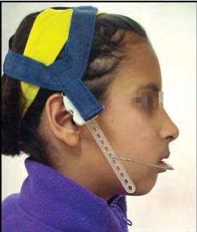
MANAGEMENT OF CLASS II MALOCCLUSION
Management Of Class II Malocclusion With Maxillary Prognathism With Normal Mandible
Here the primary goal is mainly to restrict the excessively growing maxilla. Management by extraoral force using headgears is the most effective approach.

Slide 18
MANAGEMENT OF CLASS II MALOCCLUSION
Management Of Mandibular Deficiency
Here the primary goal is to enhance mandibular growth rather than restricting the maxillary growth.
The various functional appliance used for the purpose are: activator, bionator, twin block frankel, herbst appliance
These are thought to work by unloading the mandibular condyle from the glenoid fossa (with the help of the construction bite) to a more forward position inducing an altered muscular activity.
This tends to enhance the growth in the condylar region.

Slide 19
MANAGEMENT OF CLASS II MALOCCLUSION
MANAGEMENT OF CLASS II MALOCCLUSION IN ADULTS
Since the patient has surpassed the stage when growth So dentoalveolar compensation for the skeletal defect through reduction of tooth material is the treatment of choice
For the reduction of tooth material, a proper treatment planning with the help of cephalometric analysis and model analysis are done prior to extraction.
Generally maxillary first premolars can be extracted and the maxillary anterior segment retracted in the space so created .
The case can be finished with molars in full Class II relationship.

Slide 20
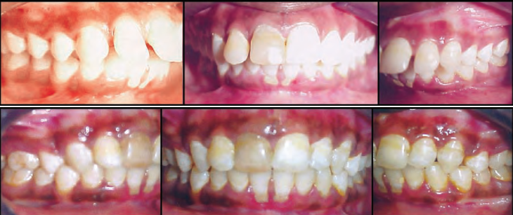

Slide 21
MANAGEMENT OF CLASS II MALOCCLUSION
MANAGEMENT OF CLASS II MALOCCLUSION BY ORTHOGNATHIC SURGERY
Any type of orthognathic surgery should be undertaken only after cessation of growth.
Presurgical orthodontics should be considered in all cases which require the repositioning of jaw segments and cases with an exaggerated curve of Spee.
Without proper interdigitation surgical results are very difficult to maintain.

Slide 22
MANAGEMENT OF CLASS II MALOCCLUSION
MANAGEMENT OF CLASS II MALOCCLUSION BY ORTHOGNATHIC SURGERY
Surgical Approaches For Maxillary Prognathism:
Total maxillary retro-positioning is thought to be a difficult procedure. The various attachments, skeletal and muscular, of the maxillary complex to
other craniofacial regions complicates its reattachment. It might also cause a reduction of the pharyngeal space. This procedure is seldom used
Partial maxillary retro-positioning is currently the most commonly used procedure.
It is relatively simple and involves the extraction of upper first premolars and the retro-positioning of maxilla in the extracted area.

Slide 23
MANAGEMENT OF CLASS II MALOCCLUSION
MANAGEMENT OF CLASS II MALOCCLUSION BY ORTHOGNATHIC SURGERY
Surgical Approaches For Mandibular Retrognathism:
The procedure that is most frequently used currently is the intraoral
bilateral, sagittal split osteotomy.
The main advantage for this procedure is a good post-treatment stability
(because of bony interfaces in the split area allows a larger area for bone apposition).
The main drawback of this surgical procedure is damage to the long buccal nerve and/or lingual nerve. This may lead to paresthesia for a period of 5-6 months, till regeneration takes place.

Slide 24
MANAGEMENT OF CLASS II DIV. 2 CASES
The treatment sequence remains the same except that for any form of treatment modality to be instituted the retroclined teeth have to be aligned in a proper labio-lingual direction.
Correction of the exaggerated curve of Spee, may also pose some problems.
The maxillary first premolars are generally extracted to create space for aligning the crowded maxillary anterior segment.
Anterior bite-planes, reverse curve of Spee wires and anchor bend in arch wires may be used to correct the anterior deep bite

Slide 25
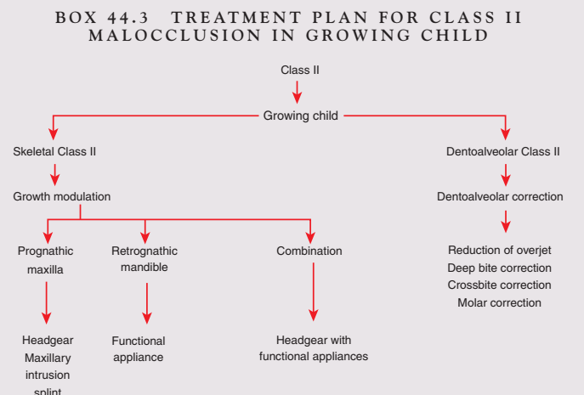
summary

Slide 26
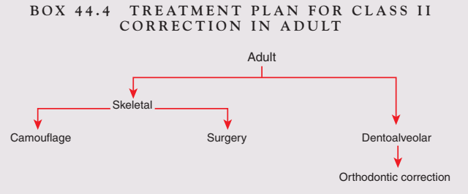
summary

Slide 27
REFERENCES
Textbook of Orthodontics – Gurkeerat Singh, Jaypee Brothers; 2nd Edition
Orthodontics – The Art and Science, S.I Bhalajhi, AryaMedi Publishing; 7th Edition
Textbook of Orthodontics – Sridhar Premkumar, Elsevier; 1st Edition
Orthodontics: Diagnosis and Management of Malocclusion and Dentofacial Deformities – O.P Kharbanda, Elsevier; 1st Edition

Slide 28
Question & Answer Session

